Slide 1


COMPUTER ORGANIZATION AND ARCHITECTURE
MODULE 1

Slide 2
MODULE 1
Basic Structure of computers :– Functional units - Basic operational concepts; Memory map; Endianness.
CISC vs RISC architectures:- RISC Introduction - Assembly Language, Assembler directives, Assembling.
Programming concepts - Program flow, Branching, Conditional statements, Loops, Arrays, Function calls; Instruction execution cycle.
Machine language - Instructions, addressing modes, Stored program concept. Evolution of the RISC Architecture.

Slide 3

Basic Structure of computers :–
Functional units –
Basic operational concepts;
Memory map; -(344 Degital design)
Endianness.-(355 Degital design)

Slide 4
WHY COMPUTER ORGANIZATION AND ARCHITECTURE?
Computer architecture is a key component of computer engineering and it is concerned with all aspects of the design and organization of the central processing unit and the integration of the CPU into the computer system itself.
Architecture extends upward into computer software because a processor’s architecture must cooperate with the operating system and system software. It is difficult to design an operating system well without knowledge of the underlying architecture.
Moreover, the computer designer must have an understanding of software in order to implement the optimum architecture.

Slide 5
Computer: A device that accepts input, processes data, stores data, and produces output, all according to a series of stored instructions.
Software: A computer program that tells the computer how to perform particular tasks.
Hardware: Includes the electronic and mechanical devices that process the data; refers to the computer as well as peripheral devices.
Peripheral devices: Used to expand the computer’s input, output and storage capabilities.
Network: Two or more computers and other devices that are connected, for the purpose of sharing data and programs.
Computer Types: Computers are classified based on the parameters like Speed of operation, Cost, Computational power and Type of application.

Slide 6
Difference between computer organization and computer architecture
Architecture describes what the computer does and organization describes how it does it.
Computer organization:
Computer organization is concerned with the way the hardware components operate and the way they are connected together to form computer system. It includes Hardware details transparent to the programmer such as control signal and peripheral. It describes how the computer performs. Example: circuit design, control signals, memory types this all are under computer organization.
Computer Architecture:
Computer architecture is concerned with the structure and behavior of computer system as seen by the user. It includes information, formats, instruction set and techniques for addressing memory. It describes what the computer does.

Slide 7
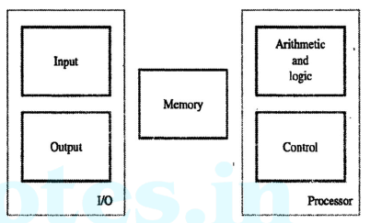
FUNCTIONAL UNITS:
The computer system is divided into five separate units for its operation.
Input Unit.
ALU.
Control Unit.
Memory Unit.
Output Unit.

Slide 8
Input & Output unit
The method of feeding data and programs to a computer is accomplished by an input device.
Computer input devices read data from a source and translate that data into electronic impulses [ADC-Analog-to-Digital converter] for transfer into the CPU.
Some typical input devices are a keyboard, a mouse, scanner, magnetic disks, etc.

Slide 9
Input & Output unit
Computer output devices converts the electronic impulses [DAC] into human readable form.
Output unit sends processed results to the outside world.
Examples: Display screens, Printers, plotters, microfilms, synthesizers, high-tech blackboards, film recorders, etc.

Slide 10
Memory Unit (MU)
A Memory Unit is a collection of storage cells together with associated circuits needed to transfer information in and out of storage.
A computer stores data or information using several methods, which leads to different levels of data storage.
Primary storage is the most common form of data storage which typically refers to the random access memory (RAM). It refers to the main storage of the computer because it holds data and applications that are currently in use by the computer.
Then, there is secondary storage which refers to the external storage devices and other external media such as hard drive and optical media.

Slide 11
Arithmetic Logical Unit (ALU)
After you enter data through the input device it is stored in the primary storage unit.
Arithmetic Logical Unit performs the actual processing of data and instruction.
The major operations performed by the ALU are addition, subtraction, multiplication, division, logic and comparison.
Data is transferred to ALU from storage unit when required.
After processing, the output is returned back to storage unit for further processing or getting stored.

Slide 12
Control Unit
Control unit controls and coordinates the entire operations of the computer system.
The control unit determines the sequence in which computer programs and instructions are executed.
It also acts as a switch board operator when several users access the computer simultaneously.
Thereby it coordinates the activities of computer’s peripheral equipment as they perform the input and output. Therefore it is the manager of all operations.

Slide 13
Central Processing Unit (CPU)
The Arithmetic Logical Unit (ALU), Control Unit (CU) and Memory Unit (MU) of a computer system are jointly known as the central processing unit.
We may call CPU as the brain of any computer system.
It is just like a human brain that takes all major decisions, makes all sorts of calculations and directs different part of the computer by activating and controlling the operations.

Slide 14
Basic operational concepts
The activity in a computer is governed by a program, which is a list of instructions stored in memory.
The Central Processing Unit (CPU), which contains the ALU and CU, executes these instructions by repeatedly following the instruction cycle (also known as the fetch-decode-execute cycle):

Slide 15
Basic operational concepts
Fetch: The CPU retrieves the next instruction from memory, at the address indicated by the program counter (PC), and loads it into the instruction register (IR).
Decode: The control unit interprets the instruction to determine what operation is to be performed and which operands are involved.
Execute: The relevant functional units (e.g., ALU) perform the operation specified by the instruction. Results are stored in registers or memory as required.
This cycle repeats continuously from the moment the computer is powered on until it is turned off.

Slide 16
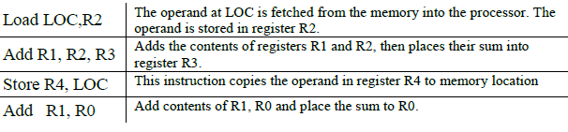
To perform a given task, an appropriate program consisting of a list of instructions is stored in the memory, Individual instructions are brought from the memory into the processor, which executes the specified operations.
[Load – Transfers data to register. Store – Transfers data to memory.] A typical instruction might be
Egs:

Slide 17
Connection Between the Processor and Memory
The figure shows how the memory and the processor can be connected.
In addition to the ALU and the control circuitry, the processor contains a number of registers used for several different purposes.

Slide 18
The instruction register (IR) holds the instruction that is currently being executed.
The program counter (PC) contains the memory address of the next instruction to be fetched and executed.
In addition to the IR and PC, general-purpose registers R0 through Rn−1, often called processor registers. They serve a variety of functions, including holding operands that have been loaded from the memory for processing.

Slide 19
Memory Address Register (MAR) is a CPU register that holds the memory address for the next read or write operation
The Memory Data Register (MDR), also called Memory Buffer Register(MBR), is a CPU register that temporarily holds data being transferred to or from main memory (RAM), acting as a buffer to sync CPU and memory speeds, while the Memory Address Register (MAR) holds the address for that data transfer, clearly separating address (MAR) from the actual data (MDR) in the fetch/store cycle.

Slide 20
Operating Steps (fetch cycle)
Programs reside in the memory entered through input devices.
PC (Program counter)has address of the first instruction or next instruction to be executed
The contents of PC are transferred to MAR (Memory Address Register) and send over system bus to memory
A Read signal is sent to the memory by control unit
The instruction (addressed word)is fetched and loaded into MDR (Memory Data Register)
The contents of MDR transferred to IR (Instruction Register)
Now the instruction is ready to be decoded and executed

Slide 21
Operating Steps (Execution Cycle)
Get operands for ALU from:
  General-purpose register (R0, … Rn-1)
  Memory
  (address to MAR, Read from mem, data to MDR, to ALU)
Perform operation in ALU
Store the result back to:
  General-purpose register (R0, … Rn-1)
  Memory
(address to MAR, result to MDR, Write to mem)
During the execution, PC is incremented to point to the next instruction

Slide 22
In addition to transferring data between the memory and the processor, the computer accepts data from input devices and sends data to output devices.
In order to respond immediately to some instruction, execution of the current program must be suspended.
To cause this, the device raises an interrupt signal, which is a request for service by the processor.
The processor provides the requested service by executing a program called an interrupt-service routine.

Slide 23
Memory map
A memory map is the organization of the computer's memory into different sections.
which defines where code, data, and stack memory are located.
memory map divides the address space into five parts or segments:
  the text,
  global data, and
  dynamic data segments, and
  segments for exception handlers and
  the operating system (OS), which includes memory dedicated to input/output (I/O).

Slide 24
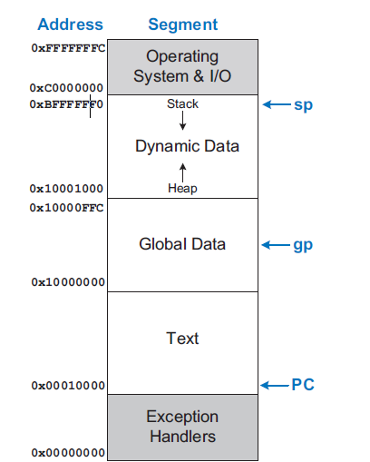
Example RISC-V memory map
RISC-V stands for Reduced Instruction Set Computing, Version 5 (pronounced "risk-five"), an open-standard Instruction Set Architecture (ISA)

Slide 25
The Text Segment
The text segment stores the machine language user program.
In addition to code, it may include literals (constants) and read-only data.

Slide 26
The Global Data Segment
•The global data segment stores global variables that, in contrast to local variables, can be accessed by all functions in a program.
•Local variables are defined within a function and can be accessed by that function; they are typically located in registers or on the stack.
•Global variables are allocated in memory before the program begins executing, they are typically accessed using the global pointer register gp that points to the middle of the global data segment.

Slide 27
Dynamic data segment
•The dynamic data segments holds the stack and the heap.
  The Stack: This region is used for managing function calls, local variables, and function parameters.
  The Heap: This region is used for dynamic memory allocation, where memory can be requested and released explicitly by the programmer during runtime
•The data in this segment is not known at the start-up but is dynamically allocated and deallocated through out the execution of the program.

Slide 28
Exception handler , OS, and and I/O Segments
•The lowest part of the example RISC-V memory map is reserved for the exception handlers and boot code that is run at start-up.
•The highest part of the memory map is reserved for the operating system and memory mapped I/O

Slide 29
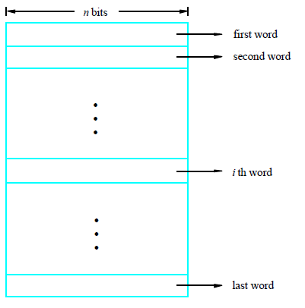
Memory Location, Addresses, and Operation
Memory consists of many millions of storage cells, each of which can store 1 bit.
Data is usually accessed in n-bit groups called word.
n is called word length.

Slide 30
Memory Location, Addresses, and Operation
The memory is organized as a two-dimensional array of memory cells.
The memory reads or writes the contents of one of the rows of the array.
This row is specified by an address.
The value read or written is called data.
An array with N-bit addresses and M-bit data has 2^{N} rows and M columns.
Each row of data is called a word. Thus, the array contains 2^{N} M-bit words.

Slide 31
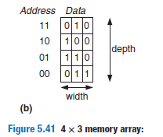
Memory Location, Addresses, and Operation
Figure shows a memory array with two address bits and three
data bits.
The two address bits specify one of the four rows (data words)
in the array.
Each data word is three bits wide

Slide 32

Memory Location, Addresses, and Operation
The depth of an array is the number of rows, and the width is the number of columns, also called the word size.
The size of an array is given as depth × width.
Figure 5.41 is a 4-word × 3-bit array, or simply 4 × 3 array.
The symbol for a 1024-word × 32-bit array is shown in Figure 5.42.
The total size of this array is 32 kilobits (Kb), also referred to as 32 kibibits (Kib).

Slide 33
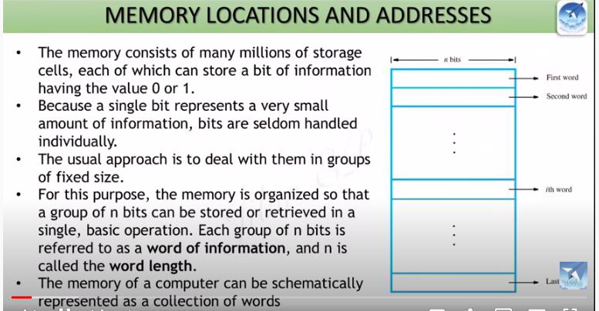

Slide 34
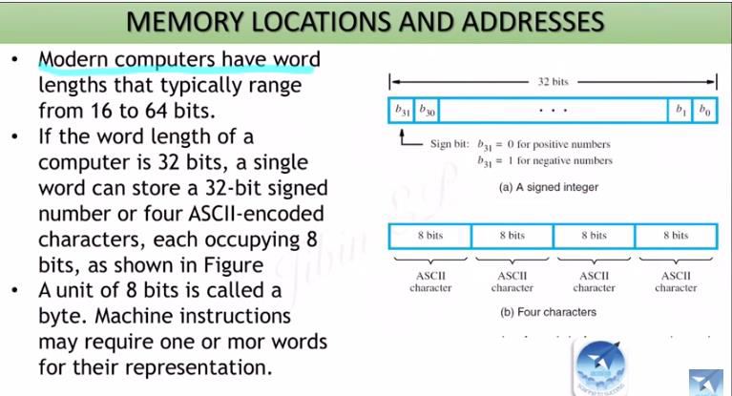

Slide 35
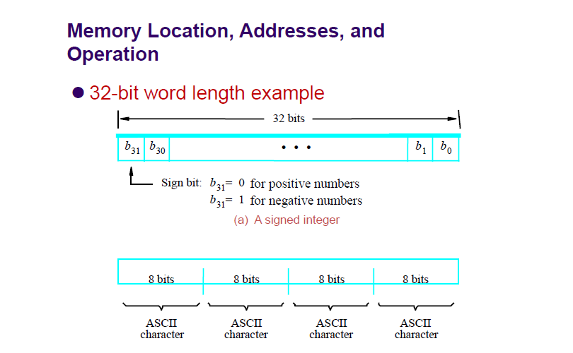

Slide 36
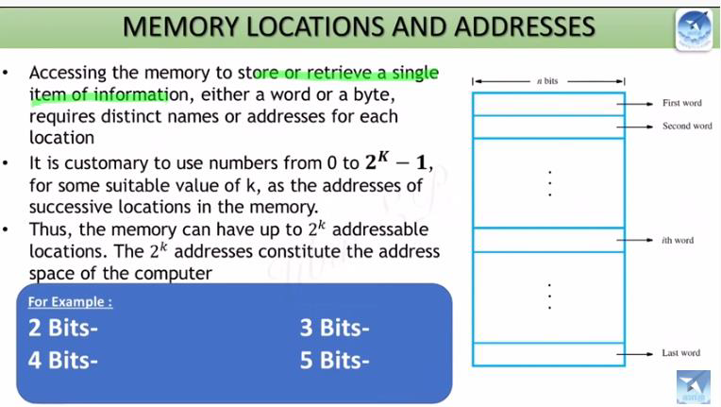

Slide 37
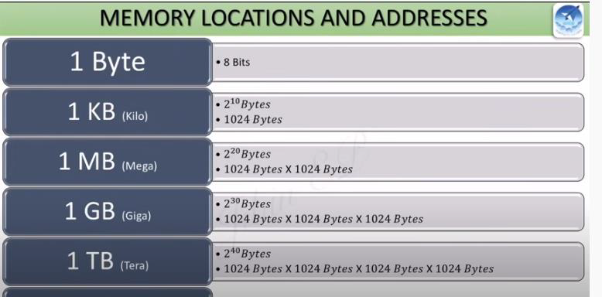

Slide 38
Byte addressability
It is impractical to assign distinct addresses to individual bit locations in the memory.
The most practical assignment is to have successive addresses refer to successive byte locations in the memory is called byte-addressable memory.
Word alignment -Words are said to be aligned in memory, if they begin at a byte address that is a multiple of the number of bytes in a word.
Byte locations have addresses -0,1, 2, 3,etc …
Word length is 16 bits, the successive words are located at addresses -0, 2, 4, 6,etc…
Word length is 32 bits, the successive words are located at addresses -0, 4, 8,12,etc…

Slide 39
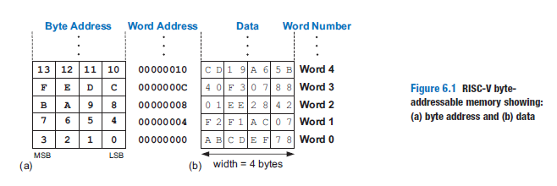
Byte addressability
RISC-V uses a byte-addressable memory.
That is, each byte in memory has a unique address, as shown in Figure 6.1(a).
A 32-bit word consists of four 8-bit bytes, so each word address is a multiple of 4.

Slide 40
Byte addressability(Endianness)
Byte-addressable memories are organized in a big-endian or little-endian fashion
In both formats, a 32-bit word’s most significant byte (MSB) is on the left and the least significant byte (LSB) is on the right.
Word addresses are the same in both formats and refer to the same four bytes.
Only the addresses of bytes within a word differ (see Figure 6.35).
In big-endian machines, bytes are numbered starting with 0 at the big (most significant) end.
In little-endian machines, bytes are numbered starting with 0 at the little (least significant) end.

Slide 41
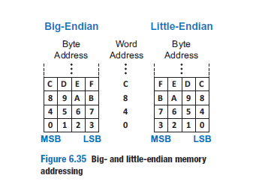
RISC-V is typically little-endian

Slide 42
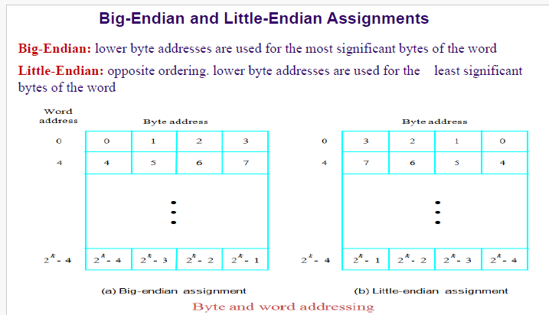

Slide 43
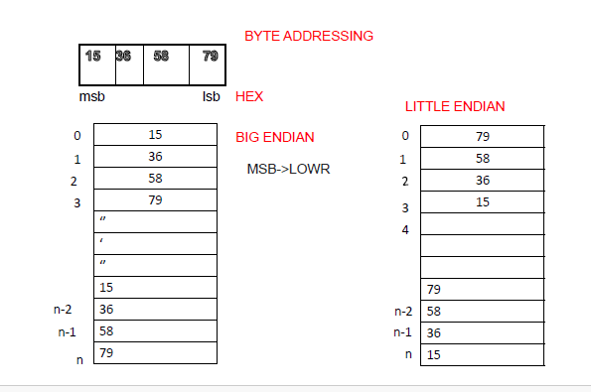

Slide 44
CISC vs RISC architectures:-
RISC Introduction –
Assembly Language,
Assembler directives, 346 degital design
Assembling.350 degital design

Slide 45
CISC –Complex Instruction Set Computer
CISC is a computer architecture in which the processor supports a large number of complex instructions
Each instruction can perform multiple low level operations such as loading data from memory, performing an arithmetic operation, and storing the result back to memory all in a single instruction
CISC instruction : ADD A, B
This might read A and B directly from memory, add them, and store the result back all in one instruction

Slide 46
Main Objectives of CISC:
• Reduce the number of instructions in a program
• Make programming easier (especially in assembly)
• Reduce memory usage by writing fewer lines of code

Slide 47
Characteristics of CISC
Large Instruction Set
CISC processors may have hundreds of instructions
Some instructions are very complex and take many steps to execute
2. Variable Length Instructions
Instructions can be 1 byte, 2 bytes, or more
This makes instruction decoding slow and complex
3. Memory to Memory Operations
Many CISC instructions can access memory directly

Slide 48
4. Multiple Clock Cycles
A single instruction may take multiple clock cycles to complete
5. Micro-programmed Control Unit
CISC processors usually use a micro-programmed control unit (A control unit whose binary control variables are stored in memory is called a micro programmed control unit.)
This increases hardware complexity but supports complex instructions
6. Many Addressing Modes
Supports many ways to access memory ( indirect, indexed, etc)
7. Difficult to Pipeline (breaking down instruction execution into smaller, sequential stages (fetch, decode, execute, etc.) that overlap, allowing multiple instructions to be processed concurrently for higher throughput, )
Because instructions vary in length and execution time, pipelining is inefficient

Slide 49
Examples of CISC:
• Intel x86 family (8086, 80286, Pentium, etc.)
• VAX
• Motorola 68000

Slide 50
RISC (Reduced Instruction Set Computer)
RISC is a CPU design approach that uses simple instructions, fixed length format, and many registers to improve speed and efficiency.
RISC is a computer architecture designed to use a small set of simple and fast instructions.
Each instruction is designed to execute in one clock cycle (ideally) and only load and store instructions access memory.
One machine instruction per machine cycle.
A machine cycle is defined to be the time it takes to fetch two operands from registers, perform an ALU operation, and store the result in a register.
Example: ARM, MIPS, SPARC, RISC-V

Slide 51
Main Objective of RISC:
Increase execution speed
Improve performance via pipelining
Simplify hardware design
Instead of performing many things in one instruction (like CISC), RISC uses many simple instructions to perform a task.

Slide 52
Basic Principles of RISC
1. Load/Store Architecture
Only two types of instructions can access memory:
LOAD–Transfers data from memory to register
STORE–Transfers data from register to memory
All other operations are done between registers
LOAD R1, A
LOAD R2, B
ADD R3, R1, R2
STORE R3, C

Slide 53
2. Fixed-Length Instructions
All instructions are same length(usually 32 bits)
This allows:
    Faster fetching
    Easier decoding
    Efficient pipelining
3. Large Number of Registers
RISC processors have more general-purpose registers
This:
    Reduces memory access
    Increases speed.

Slide 54
4. Simple Addressing Modes
Very few addressing modes (usually 3–5)
Makes circuit design simple
5. Hardwired Control Unit
Uses a hardwired control unit(generates control signals using dedicated, fixed logic circuits) instead of microprogramming
This is faster and more efficient
6. Easy Pipelining: Pipelining is a CPU hardware design technique used to enhance overall performance

Slide 55
Advantages of RISC
•Faster execution
•Simple hardware
•Low power consumption
•Easy pipelining
•Better performance per watt
Disadvantages of RISC
•More lines of code
•Requires better compiler optimization
•Higher memory usage

Slide 56
•Advantages of CISC
•Less code required
•Easier for assembly language programming
•More powerful single instructions
•Disadvantages of CISC
•Complex hardware
•Slower execution
•High power consumption
•Difficult pipelining

Slide 57
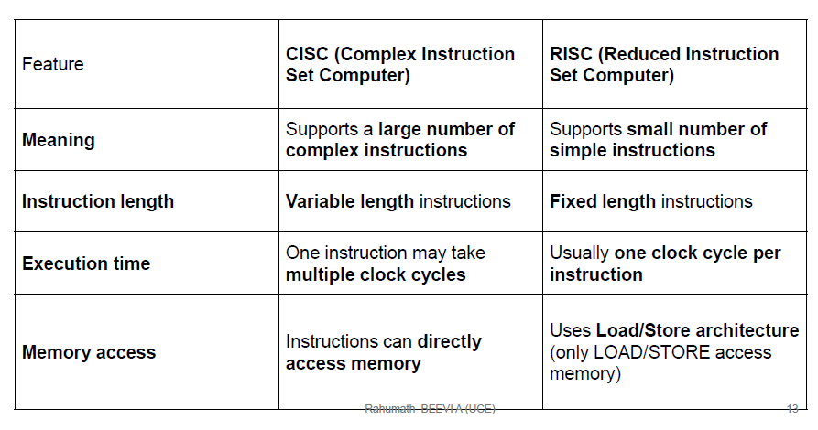
RISC vs RISC Architectures

Slide 58
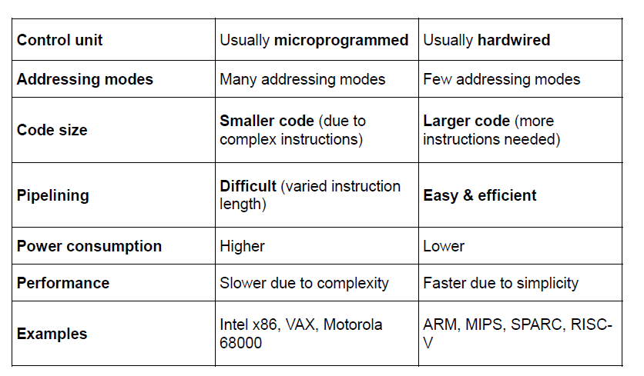

Slide 59
RISC designs may benefit from the inclusion of some CISC features
CISC designs may benefit from the inclusion of some RISC features
The result is that the more recent RISC designs, notably the PowerPC, are no longer “pure RISC and the more recent CISC designs, notably the Pentium II and later Pentium models, do incorporate some RISC characteristics

Slide 60
Assembly language
Assembly language is the human-readable representation of the computer’s native language.
Each assembly language instruction specifies both the operation to perform and the operands on which to operate.
Assembly language for RISC architectures is a low level programming language that provides direct control over the processor's operations using mnemonic codes that closely correspond to machine code instructions.
Mnemonics and Operands: Each instruction is represented by a mnemonic (e g: ADD, LOAD, STORE) combined with one or more operands, which specify the data or registers involved.

Slide 61
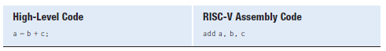
Assembly language
The first part of the assembly instruction, add, is called the mnemonic and indicates what operation to perform.
The operation is performed on b and c, the source operands, and the result is written to a, the destination operand.

Slide 62
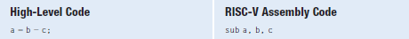
The sub instruction format is the same as the add instruction: destination operand, followed by two sources.
This consistent instruction format is an example of the first design principle of computer architecture.
Instructions with a consistent number of operands—in this case, two sources and one destination—are easier to encode and handle in hardware.
More complex high-level code translates into multiple RISC-V instructions.

Slide 63
First design principle of computer architecture.
This consistent instruction format, i.e; instructions with a consistent number of operands and are easier to encode and handle in hardware.

Slide 64
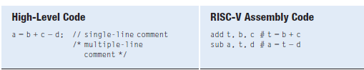
The assembly language program stores the intermediate result (b + c) in a temporary variable t.
Using multiple assembly language instructions to perform more complex operations is an example of the second design principle of computer architecture:

Slide 65
second design principle of computer architecture:
Using multiple assembly language instructions to perform more complex operations

Slide 66
The RISC-V instruction set makes the common case fast by including only simple, commonly used instructions.
The number of instructions is kept small so that the hardware required to decode the instruction and its operands can be simple, small, and fast.
More elaborate operations that are less common are performed using sequences of multiple simple instructions.
Thus, RISC-V is a reduced instruction set computer (RISC) architecture.

Slide 67
Architectures with many complex instructions, such as Intel’s x86 architecture, are complex instruction set computers (CISC).
The cost of implementing complex instructions in a CISC architecture is added hardware and overhead that slows down the simple instructions.
A RISC architecture, such as RISC-V, minimizes the hardware complexity and the necessary instruction encoding by keeping the set of distinct instructions small.

Slide 68
Operands: Registers, Memory, and Constants
An instruction operates on operands.
The variables a, b, and c are all operands(above examples).
But computers operate on 1’s and 0’s, not variable names.
The instructions need a physical location from which to retrieve the binary data.
Operands can be stored in registers or memory, or they may be constants stored in the instruction itself.

Slide 69
Operands: Registers, Memory, and Constants
Computers use various locations to hold operands in order to optimize for speed and data capacity.
Operands stored as constants or in registers are accessed
quickly, but they hold only a small amount of data.
Additional data must be accessed from memory, which is large but slow.
RISC-V is called a 32-bit architecture because it operates on 32-bit data.

Slide 70
Operands: Registers
Instructions need to access operands quickly so that they can run fast, but operands stored in memory take a long time to retrieve.
Therefore, most architectures uses a small number of registers that hold commonly used operands.
The RISC-V architecture has 32 registers, called the register set, stored in a small multi-ported memory called a register file.
The fewer the registers, the faster they can be accessed.
This leads to the third design principle:
Design Principle 3: Smaller is faster.

Slide 71
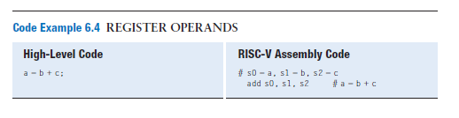
Operands: Registers
The add instruction with register operands.
The variables a, b, and c are arbitrarily placed in s0, s1, and s2.
The instruction adds the 32-bit values contained in s1 (b) and s2 (c) and writes the 32-bit result to s0 (a)

Slide 72
The Register Set
Table 6.1 lists the name and use for each of the 32 RISC-V registers.
Registers are numbered 0 to 31 and are given a special name to indicate a register’s conventional purpose.
Assembly instructions typically use the special name—for example, s1—for clarity, but they may also use the register number (e.g., x9 for register number 9).

Slide 73
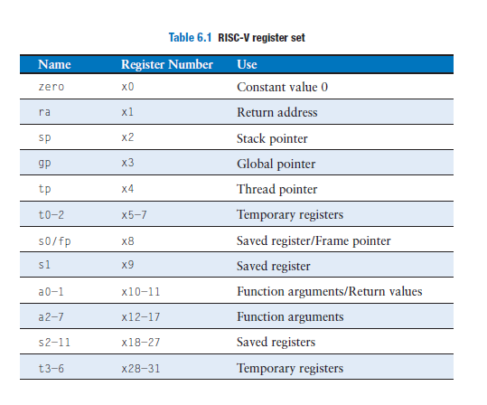

Slide 74
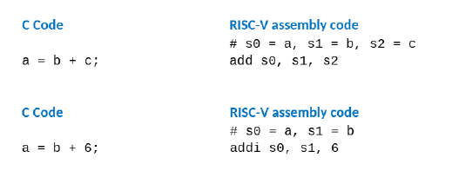
The Register Set
The zero register always holds the constant 0; values written to it are discarded.
Registers s0 to s11 (registers 8–9 and 18–27) and t0 to t6 (registers 5–7 and 28–31) are used for storing variables;
ra and a0 to a7 have special uses during function calls
Registers 2 to 4 are also called sp, gp, and tp

Slide 75
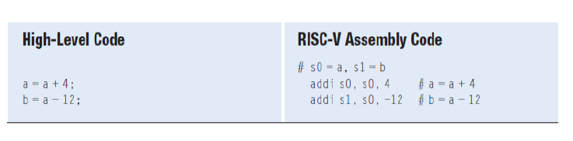
Constants/Immediates
In addition to register operations, RISC-V instructions can use constant or immediate operands.
These constants are called immediates because their values are immediately available from the instruction and do not require a register or memory access.
The add immediate instruction, addi, that adds an immediate to a register.

Slide 76
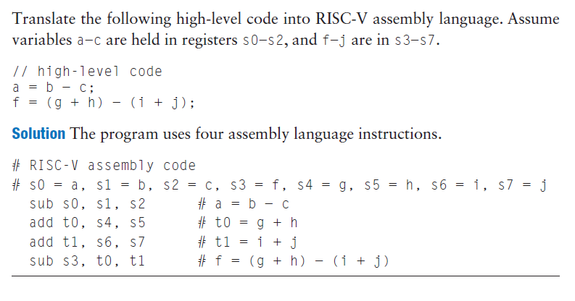

Slide 77
Operands: Memory
If registers were the only storage space for operands, we would be confined to simple programs with no more than 32 variables.
However, data can also be stored in memory.
Whereas the register file is small and fast, memory is larger and slower.
For this reason, frequently used variables are kept in registers.
In the RISC-V architecture, instructions operate exclusively on registers, so data stored in memory must be moved to a register before it can be processed.
By using a combination of memory and registers, a program can access a large amount of data quickly.

Slide 78
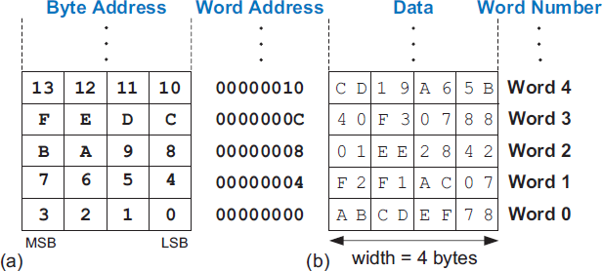
RISC-V uses a byte-addressable memory. That is, each byte in memory has a unique address,
A 32-bit word consists of four 8-bit bytes, so each word address is a multiple of 4. each data word is 4 bytes, so the word address is four times the word number. Word number 0 is at address 0, word 1 is at address 4, word 2 at address 8, and so on.
RISC-V byte addressable memory showing:
(a) byte address and (b) data

Slide 79
READING MEMORY :330
The load word instruction, lw, reads a data word from memory into a register
The lw (Load Word) instruction is used to load a 32-bit word (4 bytes) from memory into a register.
The lw instruction specifies the memory address using an offset added to a base register.

Slide 80
Syntax : lw destination, offset(base)
lw rd, offset(rs1)
rd ← Memory[ rs1 + offset ]
rd → destination register
rs1 → base address register
offset →offset is a constant value (immediate) used along with a base register to calculate a memory address.

Slide 81
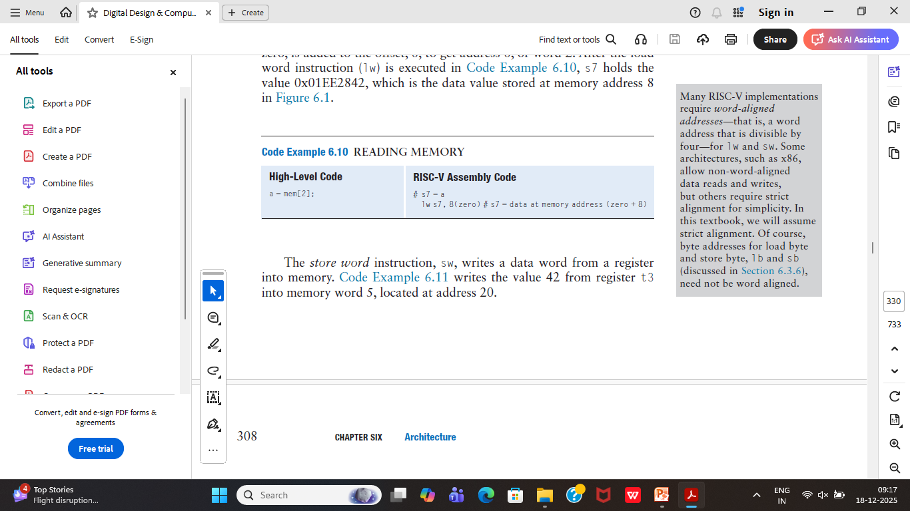
READING MEMORY :330
The example, loads memory word 2, located at address 8, into a (s7).
In this example, the base register, zero, is added to the offset, 8, to get address 8, or word 2.
After the load word instruction (lw) is executed, s7 holds the value 0x01EE2842, which is the data value stored at memory address 8

Slide 82
READING MEMORY
Eg: lw x5, 8(x10)
    Effective address = x10 + 8
    Load 4 bytes from that memory location
    Store the value into register x5
Eg: To read a word of data at memory address 1 into s3
    Assembly code
    lw s3, 1(zero) # read memory word 1 into s3

Slide 83
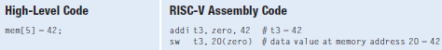
WRITING MEMORY
The store word instruction, sw, writes a data word from a register into memory.
Example writes the value 42 from register t3 into memory word 5, located at address 20.

Slide 84
WRITING MEMORY
sw rs2, offset(rs1)
rs2 → Memory[rs1 + offset]
Source: rs2 (register containing the data)
Destination: Memory[ rs1 + offset ] (memory location)
Source → Destination

Slide 85
eg: sw x5, 8(x10)
    x5 → Memory[ x10 + 8 ]
Eg: store the value held in t7into memory address 0x10
    sw t7, 0x10(zero) # write t7 into address 16
    if t7 holds the value 0xAABBCCDD, then after the sw completes, at address 0x10 in memory will contain that value

Slide 86
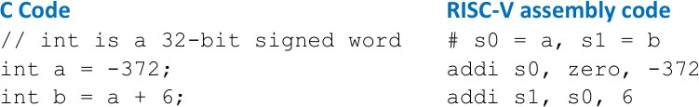
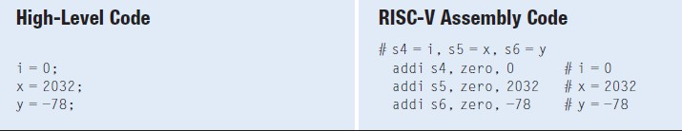
Generating 12-Bit Constants
12-bit signed constants (immediates) using addi :

Slide 87
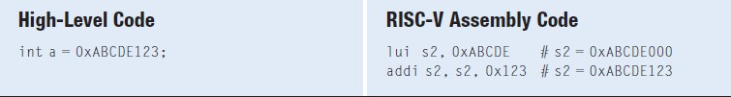
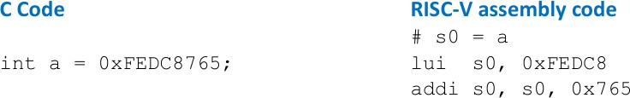
Generating 32-bit Constants
To create larger constants, use a load upper immediate instruction
(lui) followed by an add immediate instruction (addi)
The lui instruction loads a 20-bit immediate into the most significant 20 bits of the instruction and places zeros in the least significant bits.

Slide 88
Assembler Directives
Assembler directives guide the assembler in allocating and initializing global variables, defining constants, and differentiating between code and data.
Assembler directives are commands for the assembler program itself, not instructions to be executed by the CPU. They help manage the assembly process.
Assembler directives (also called pseudo-ops) do NOT generate machine instructions. They tell the assembler how to organize memory

Slide 89
The .data, .text, .bss, and .section .rodata assembler directives tell the assembler to place the proceeding data or code in the global data, text (code), BSS, or read-only data (.rodata) segments of memory, respectively.
• The BSS segment is located in the global data segment but is initialized to zero.
• The read-only data segment is constant data that is placed in the text segment (i.e., in the program memory).
➢.text → Stores executable instructions
➢.data → Stores initialized global variables
➢.bss →Stores uninitialized global variables (set to 0)
➢.rodata → Stores constants (read-only data)

Slide 90
Common directives include
.data: Marks the start of a data segment where variables are defined and initialized.
.text: Indicates the beginning of the section containing executable instructions.
.globl: Declares a symbol (label) as global, allowing it to be used by other assembly modules.
.word, .byte, .space: Used to allocate and initialize memory storage for data of specific sizes or reserve uninitialized space.
.end: Marks the end of the source code file

Slide 91
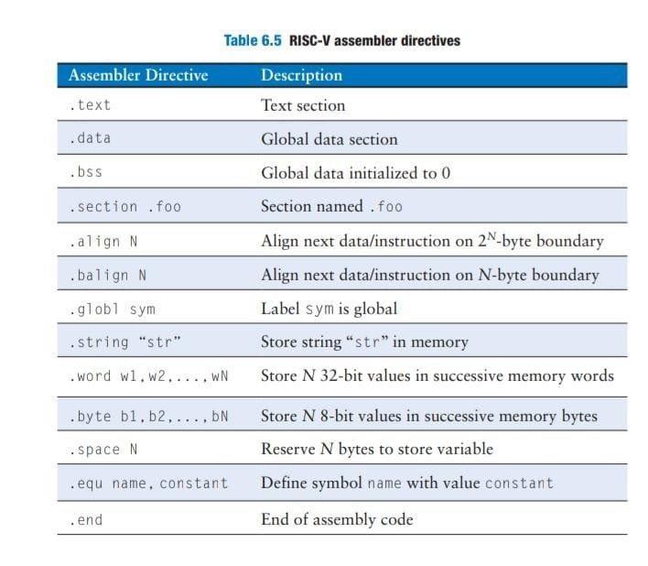

Slide 92
Assembling
An assembler turns the assembly language code into an object file containing machine language code.
Assembly language → Assembler → Machine language.
Source Code: A programmer writes a program in assembly language using mnemonics and directives.
Assembler: The assembler reads the source file and performs the translation.
It converts mnemonics into their corresponding binary machine code (opcodes) and uses the directives to manage memory allocation and program structure.

Slide 93
Object File Generation: The output of the assembler is an object file, which contains machine code and information about symbols and data locations.
Linking: A linker combines multiple object files and necessary software libraries into a single, final executable program.
Execution: The executable file is loaded into memory and run by the processor.

Slide 94
source.s/c
↓
Assembler
↓
object.o
↓
Linker
↓
Executable file

Slide 95
Programming concepts -
Program flow,
Branching,
Conditional statements,
Loops,
Arrays,
Function calls;
Instruction execution cycle.

Slide 96
PROGRAMMING CONCEPTS…page 331
Software languages such as C or Java are called high-level programming languages because they are written at a more abstract level than assembly language.
Many high-level languages use common software constructs, such as arithmetic and logical operations, if/else statements, for and while loops, array indexing, and function calls.

Slide 97
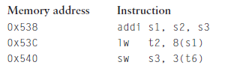
PROGRAM FLOW
Instructions are stored in memory.
Each instruction is 32 bits (4 bytes) long, so consecutive instruction addresses increase by four.
For example, in the code below, the addi instruction is located in memory at address 0x538 and the next instruction, lw, is at address 0x53C.

Slide 98
The program counter—also called the PC—keeps track of the current instruction.
The PC holds the memory address of the current instruction and increments by four after each instruction completes so that the processor can read or fetch the next instruction from memory.
For example, when addi is executing, PC is 0x538.
After addi completes, PC increments by four to 0x53C and the processor fetches the lw instruction at that address.

Slide 99
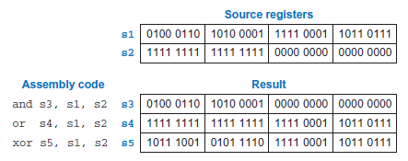
Logical, Shift, and Multiply Instructions
Logical Instructions
RISC-V logical operations include and, or, and xor.
These each operate bitwise on two source registers and write the result to a destination register, as shown below.
Immediate versions of these logical operations, andi, ori, and xori, use one source register and a 12-bit sign-extended immediate.

Slide 100
AND INSTRUCTION
The and instruction is useful for clearing or masking bits (i.e., forcing bits to 0).
For example, the and instruction in Figure above clears the bits in s1 that are low in s2. In this case, the bottom two bytes of s1 are cleared.
The unmasked top two bytes of s1, 0x46A1, are placed in s3.
Any subset of register bits can be cleared.
For example, to clear bit 3 of s0 and place the result in s6, use
andi s6, s0, 0xFF7.

Slide 101
OR INSTRUCTION
The or instruction is useful for combining bit fields from two registers.
For example, 0x347A0000 OR 0x000072FC = 0x347A72FC.
It can also be used to set bits in a register (i.e., force a bit to 1).
For example, to set bit 5 of s0 and place the result in s7, use
ori s7, s0, 0x020.

Slide 102
NOT operation
A logical NOT operation can be performed with xori s8, s1, −1.
Remember that −1 (0xFFF) is sign-extended to 0xFFFFFFFF (all 1’s).
XOR with all 1’s inverts all the bits, so s8 will get the one’s complement of s1.

Slide 103
Shift Instructions
Shift instructions shift the value in a register left or right, dropping bits off the end.
RISC-V shift operations are sll (shift left logical), srl (shift right logical), and sra (shift right arithmetic).
Left shifts always fill the least significant bits with zeros.
Right shifts can be either logical (zeros shift into the most significant bits) or arithmetic (the sign bit shifts into the most significant bits).

Slide 104
These shifts specify the shift amount in the second source register.
Immediate versions of each instruction are also available (slli, srli, and srai), where the amount to shift is specified by a 5-bit unsigned immediate.

Slide 105
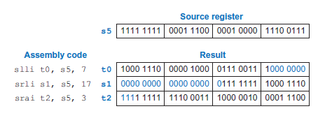
Figure shows the assembly code and resulting register values for slli, srli, and srai when shifting by an immediate value.
s5 is shifted by the immediate amount, and the result is placed in the destination register.

Slide 106
Shifting a value left by N is equivalent to multiplying it by 2^{N}.
For example, slli s0, s0, 3 multiplies s0 by 8 (i.e., 23).
Likewise, shifting a value right by N is equivalent to dividing it by 2^{N}.
Arithmetic right shifts divide two’s complement numbers, while logical right shifts divide unsigned numbers.

Slide 107
Multiply Instructions
Multiplying two N-bit numbers produces a 2N-bit product.
The RISC-V architecture provides various multiply instructions that result in 32- or 64-bit products.
The multiply instruction (mul) multiplies two 32-bit numbers and produces a 32-bit product.
mul s1, s2, s3 multiplies the values in s2 and s3 and places the least significant 32 bits of the product in s1; the most significant 32 bits of the product are discarded.
This instruction is useful for multiplying small numbers whose product fits in 32 bits.
The bottom 32 bits of the product are the same whether the operands are viewed as signed or unsigned.

Slide 108
Multiply Instructions
Three versions of the “multiply high” operation exist: mulh, mulhsu, and mulhu.
These instructions put the high 32 bits of the multiplication result in the destination register.
mulh (multiply high signed signed) treats both operands as signed.
mulhsu (multiply high signed unsigned) treats the first operand as signed and the second as unsigned, and
mulhu (multiply high unsigned unsigned) treats both operands as unsigned
Page 334

Slide 109
Branching
Branch instructions modify the flow of the program so that the processor can fetch instructions that are not in sequential order in memory.
They modify the PC to skip over sections of code or to repeat previous code.
An advantage of a computer over a calculator is its ability to make decisions.
Page 334

Slide 110
Branching
A computer performs different tasks depending on the input.
For example, if/else statements, switch/case statements, while loops, and for loops - all conditionally execute code depending on some test.
Conditional branch instructions perform a test and branch only if the test is TRUE.
Unconditional branch instructions, called jumps, always branch.
Page 334

Slide 111
Conditional Branches
The RISC-V instruction set has six conditional branch instructions, each of which take two source registers and a label indicating where to go.
beq (branch if equal) branches when the values in the two source registers are equal.
bne (branch if not equal) branches when they are unequal.
blt (branch if less than) branches when the value in the first source register is less than the value in the second

Slide 112
Conditional Branches
bge (branch if greater than or equal to) branches when the first is greater than or equal to the second.
blt and bge treat the operands as signed numbers, while bltu and bgeu treat the operands as unsigned.

Slide 113
Conditional Branches
Assembly code uses labels to indicate instruction locations in the program.
A label refers to the instruction just after the label.
When the assembly code is translated into machine code, these labels correspond to instruction addresses .
RISC-V assembly labels are followed by a colon (:).

Slide 114
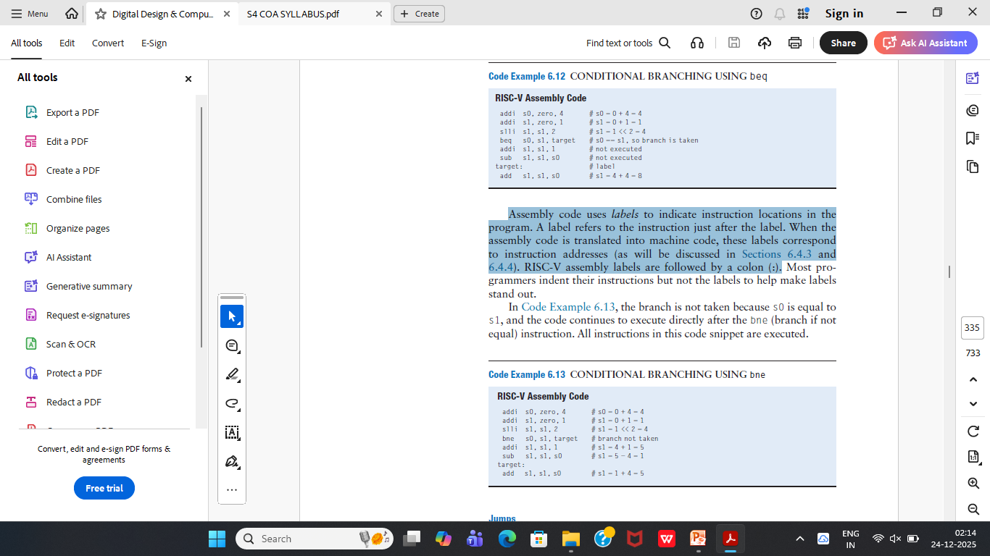
Conditional Branches
When the program reaches the branch if equal instruction (beq), the value in s0 is equal to the value in s1, so the branch is taken.
Thus, the next instruction executed is the add instruction just after the label called target.
The addi and sub instructions between the branch and the label are not executed.

Slide 115
Conditional Branches

Slide 116
Jumps
A program can jump—that is, unconditionally branch—using one of three instructions: jump (j), jump and link (jal), or jump register (jr).
j jumps directly to the instruction at the specified label.
The jump and link instruction (jal) is used to call a function
and the jump register instruction (jr) is used to return from a function.

Slide 117
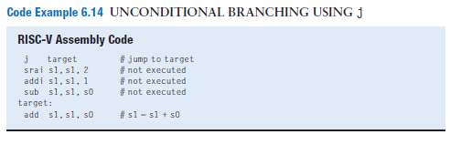
Code Example shows the use of the j (jump) instruction to skip over three instructions and continue at the add instruction after the label target.
After the j instruction executes, this program unconditionally continues executing the add instruction at the label target.
All of the instructions between the jump and the label are skipped.

Slide 118
Conditional Statements
If, if/else, and switch/case statements are conditional statements commonly used in high-level languages.
They each conditionally execute a block of code consisting of one or more statements

Slide 119
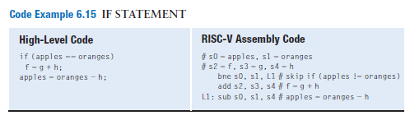
If Statements
An if statement executes a block of code, the if block, only when a
condition is met.
The assembly code for the if statement tests the opposite condition of the one in the high-level code.
In Code Example, the high-level code tests for apples = = oranges.
The assembly code tests for apples != oranges using bne to skip the if block if the condition is not satisfied.
Otherwise (i.e., when apples = = oranges), the branch is not taken, and the if block is executed.

Slide 120
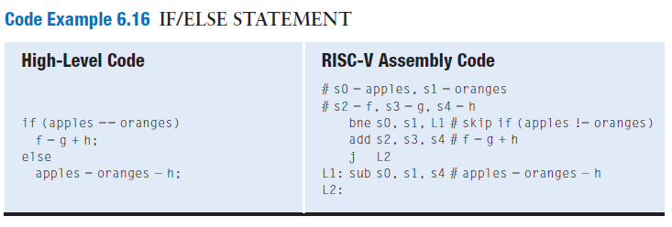
If/else Statements : 337
If/else statements execute one of two blocks of code, depending on a condition.
When the condition in the if statement is met, the if block is executed.
Otherwise, the else block is executed.

Slide 121
Switch/case Statements
Switch/case statements, also called simply case statements, execute one of several blocks of code, depending on the conditions.
If no conditions are met, the default block is executed.
A case statement is equivalent to a series of nested if/else statements.

Slide 122
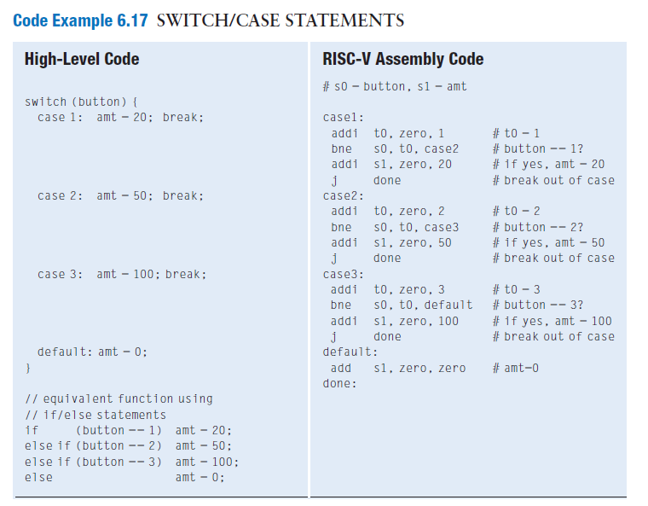

Slide 123
Loops
Loops repeatedly execute a block of code, depending on a condition.
While loops and for loops are commonly used in high-level languages.

Slide 124
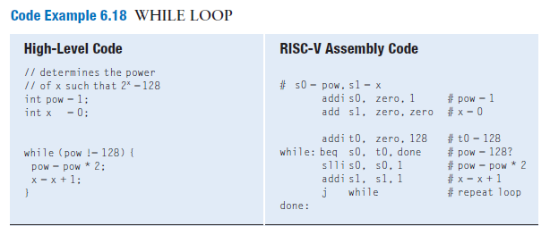
While Loops
While loops repeatedly execute a block of code while a condition is met— that is, until a condition is not met.

Slide 125
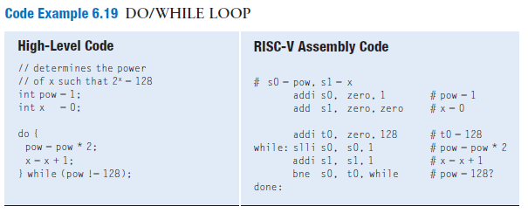
While Loops
Do/while loops are similar to while loops, but they execute the body of the loop once before checking the condition.

Slide 126
For Loops
It is very common to initialize a variable before a while loop, check that variable in the loop condition, and change that variable each time through the while loop.
For loops are a convenient shorthand that combines the initialization, condition check, and variable change in one place.
The high-level code format of the for loop is:
for (initialization; condition; loop operation)
statement

Slide 127
For Loops
for (initialization; condition; loop operation)
statement
The initialization code executes before the for loop begins.
The condition is tested at the beginning of each loop iteration.
If the condition is not met, the loop exits.
If the condition is met, the statement (or statements) in the loop body are executed.
The loop operation executes at the end of each loop iteration.

Slide 128
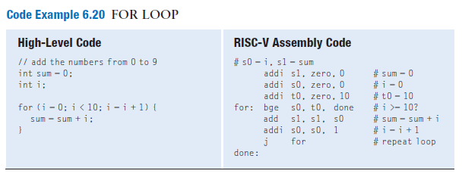

Slide 129
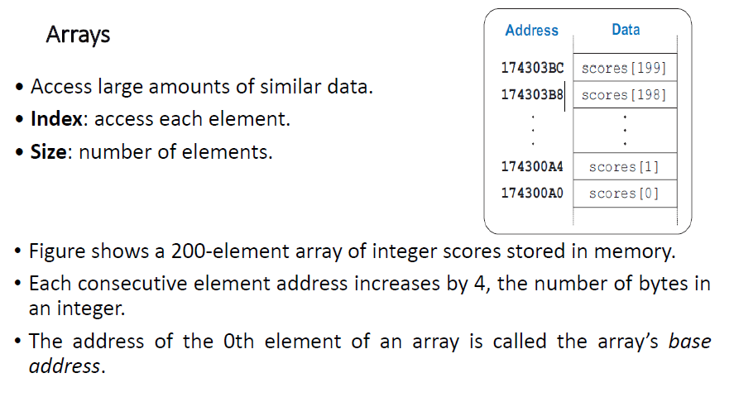

Slide 130
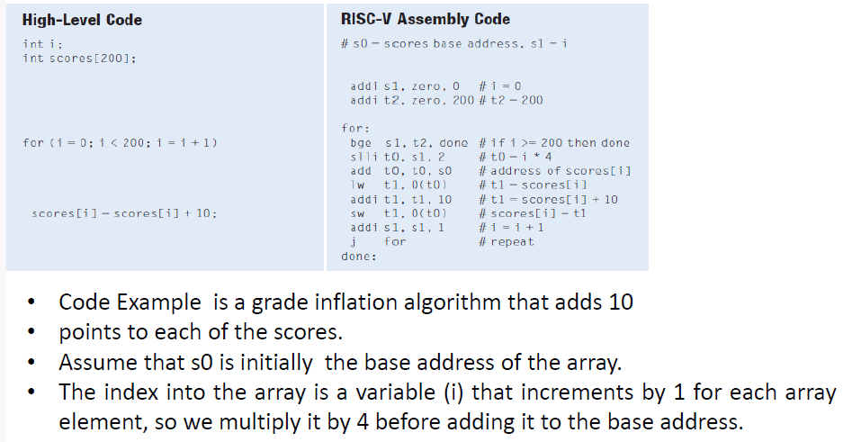

Slide 131
Function Calls : 343
High-level languages support functions (also called procedures or subroutines) to reuse common code and to make a program more modular and readable.
Functions may have inputs, called arguments, and an output, called the return value.
When one function calls another, the calling function, the caller, and the called function, the callee, must agree on where to put the arguments and the return value.

Slide 132
In RISC-V programs, the caller conventionally places up to eight arguments in registers a0 to a7 before making the function call,
and the callee places the return value in register a0 before finishing.
By following this convention, both functions know where to find the arguments and return value, even if the caller and callee were written by different people.

Slide 133
The caller stores the return address in the return address register (ra) at the same time it jumps to the callee using the jump and link instruction (jal).
The callee must not overwrite any architectural state or memory that the caller is depending on.
Specifically, the callee must leave the saved registers (s0−s11), the return address (ra), and the stack, a portion of memory used for temporary variables, unmodified.

Slide 134
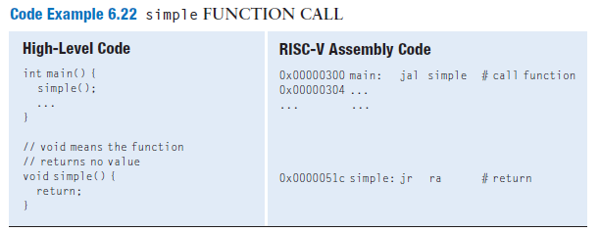
Function Calls and Returns
RISC-V uses the jump and link instruction (jal) to call a function and the jump register instruction (jr) to return from a function.

Slide 135
Function Calls and Returns
Code Example shows the main function calling the simple function.
main is the caller and simple is the callee.
The simple function is called with no input arguments and generates no return value; it just returns to the caller.
jal and jr ra are the two essential instructions needed for a function call and return.

Slide 136
Function Calls and Returns
The main function calls the simple function by executing jal simple, which performs two tasks:
  It jumps to the target instruction located at simple (0x0000051C)
  and it stores the return address, the address of the instruction after jal (in this case, 0x00000304) in the return address register (ra).
The programmer can specify which register gets written with the return address, but the default is ra.
So, jal simple is equivalent to jal ra, simple and is the preferred style.
The simple function returns immediately by executing the instruction jr ra, which jumps to the instruction address held in ra.
The main function then continues executing at this address (0x00000304).

Slide 137
Input Arguments and Return Values
By RISC-V convention, functions use a0 to a7 for input arguments and a0 for the return value.
In Code Example, the function diffofsums is called with four arguments and returns one result.
result is a local variable, which we choose to keep in s3.
According to RISC-V convention, the calling function, main, places the function arguments from left to right into the input registers, a0 to a7, before calling the function.
The called function, diffofsums, stores the return value in the return register, a0.
When a function with more than eight arguments is called, the additional input arguments are placed on the stack,

Slide 138
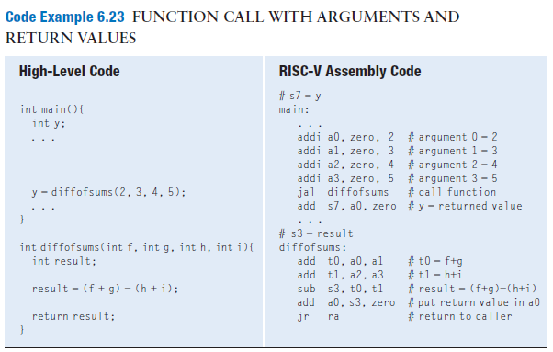

Slide 139
The Stack
The stack is memory that is used as scratch space—that is, to save temporary information within a function.
The stack expands (uses more memory) as the processor needs more scratch space and contracts (uses less memory) when the processor no longer needs the variables stored there.
The stack is a last-in-first-out (LIFO) queue.
The last item pushed onto the stack (the top) is the first one that can be popped off (removed).
Each function may allocate stack space to store local variables and to use as scratch space, but the function must deallocate it before returning.

Slide 140
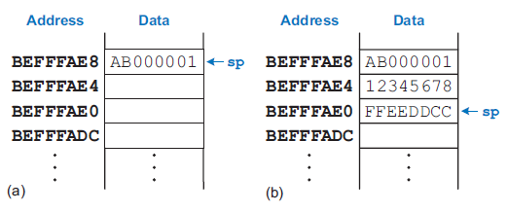
The Stack
The top of the stack is the most recently allocated space.
The stack pointer, sp (register 2), is an ordinary RISC-V register that, by convention, points to the top of the stack.
sp points to (gives the address of) data.
The stack pointer (sp) starts at a high memory address and decrements to expand as needed

Slide 141
The Stack
To solve this problem, a function saves registers on the stack and then restores them from the stack before it returns.
Specifically, it performs the following steps:
1. Makes space on the stack to store the values of one or more registers
2. Stores the values of the registers on the stack
3. Executes the function using the registers
4. Restores the original values of the registers from the stack
5. Deallocates space on the stack
The stack space that a function allocates for itself is called its stack
frame.

Slide 142
The Stack
RISC-V divides registers into preserved and nonpreserved categories.
Preserved registers must contain the same values at the beginning and end of a called function because the caller expects preserved register values to be the same after the call.
The preserved registers are s0 to s11 , sp, and ra.
The nonpreserved registers, also called scratch registers, are t0 to t6 (hence their name, temporary) and a0 to a7, the argument registers.

Slide 143
The Stack
A function that does not call other functions is called a leaf function.
A function that does call others is called a nonleaf function.
Leaf functions may need to save non preserved registers on the stack before they call another function and then restore those registers afterward.
Specifically, they must follow these rules:
  Caller save rule: Before a function call, the caller must save any nonpreserved registers (t0–t6 and a0–a7) that it needs after the call. After the call, it must restore these registers before using them.
  Callee save rule: Before a callee disturbs any of the preserved registers (s0–s11 and ra), it must save the registers. Before it returns, it must restore these registers.

Slide 144
The Stack
A recursive function is a nonleaf function that calls itself.
Recursive functions behave as both caller and callee and must save both preserved and nonpreserved registers.

Slide 145
The Stack
A recursive function is a nonleaf function that calls itself.
Recursive functions behave as both caller and callee and must save both preserved and nonpreserved registers.

Slide 146
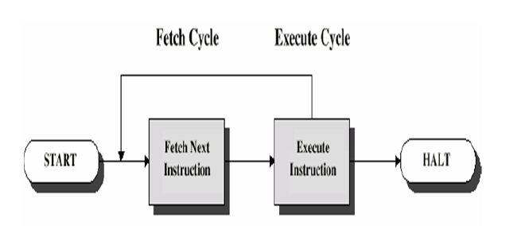
Instruction execution cycle

Slide 147
Instruction execution cycle: Typical Operating Steps (Fetch Cycle)
Programs reside in the memory entered through input devices
Execution of the program starts when the PC is set to point at the first instruction of the program
PC (Program counter) has address of the first instruction or next instruction to be executed
The contents of PC are transferred to MAR (Memory Address Register) and send over system bus to memory
A Read signal is sent to the memory by control unit
The instruction addressed word) is fetched and loaded into MDR (Memory Data Register) after duration of memory access time
The contents of MDR transferred to IR (Instruction Register)
Now the instruction is ready to be decoded and executed

Slide 148
Instruction execution cycle: Typical Operating Steps (Execution Cycle)
If the instruction involves an operation by the ALU, Get operands for ALU from
  General purpose register (R0,… Rn-1)
  Memory
  (address to MAR, Read frm mem data to MDR, to ALU)
After one or two such repeated cycles, Perform operation in ALU
Store the result back to:
  General purpose register (R 0 Rn 1
  Memory
  (address to MAR, result to MDR, Write to mem)
During the execution, PC is incremented to point to the next instruction
❖
In addition to transferring data between memory and processor, computer accepts data from input devices and sends data to output devices Instructions to handle I/O transfers, I/O Address Register, I/O Data
Register etc provided

Slide 149
Machine language -
Instructions,
addressing modes,
Stored program concept.
Evolution of the RISC Architecture.

Slide 150
MACHINE LANGUAGE…page 355
Assembly language is convenient for humans to read.
However, digital circuits understand only 1’s and 0’s.
Therefore, a program written in assembly language is translated from mnemonics to a representation using only 1’s and 0’s, called machine language.

Slide 151
MACHINE LANGUAGE…page 355
RISC-V uses 32-bit instructions.
Even though some instructions may not require all 32 bits of encoding, variable-length instructions would add complexity.
Simplicity would also encourage a single-instruction format, but that is too restrictive.
This issue allows to introduce the last design principle:
Design Principle 4: Good design demands good compromises.
RISC-V makes the compromise of defining four main instruction
formats: R-type, I-type, S/B-type, and U/J-type.

Slide 152
INSTRUCTION FORMATS
RISC-V has four main instruction formats: R-type, I-type, S/B-type, and U/J-type.
R-type (register) instructions, such as add s0, s1, s2, operate on three registers.
I-type (immediate) instructions, such as addi s3, s4, 42
S/B-type (store/branch) instructions, such as sw a0, 4(sp) or beq a0,a1,L1, operate on two registers and a 12- or 13-bit signed immediate.
U/J-type (upper immediate/jump) instructions, such as jal ra, factorial, operate on one register and a 20- or 21-bit immediate.

Slide 153
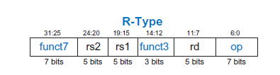
R-Type Instructions
R-type (register-type) instructions use three registers as operands: two ascsources and one as a destination.
Figure shows the R-type machine instruction format.
The 32-bit instruction has six fields: funct7, rs2, rs1, funct3, rd, and op.
Each field is three to seven bits, as indicated.

Slide 154
I-Type Instructions
I-type (immediate) instructions use two register operands and one immediate operand.
I-type instructions include addi, andi, ori, and xori, loads (lw, lh, lb, lhu, and lbu), and register jumps (jalr).
Figure below shows the I-type machine instruction format.
It is similar to R-type but includes a 12-bit immediate field imm instead of the funct7 and rs2 fields.
rs1 and imm are the source operands, and rd is the destination register.

Slide 155


Slide 156
S/B-Type Instructions
S/B-type (store/branch) instructions use two register operands and one immediate operand.
Both of the register operands are source registers (rs1 and rs2) in S/B-type
Figure shows the S/B-type machine instruction format.
The instruction replaces the funct7 and rd fields of R-type instructions with the 12-bit immediate imm.
Thus, this immediate field is split across two bit ranges, bits 31:25 and bits 11:7, of the instruction.

Slide 157


Slide 158
S/B-Type Instructions
Store instructions use S-type and branch instructions use B-type.
S- and B-type formats differ only in how the immediate is encoded.
S-type instructions encode a 12-bit signed (two’s complement) immediate, with the top seven bits (imm11:5) in bits 31:25 of the instruction and the lower five bits (imm4:0) in bits 11:7 of the instruction.

Slide 159
S/B-Type Instructions
B-type instructions encode a 13-bit signed immediate representing
the branch offset, but only 12 of the bits are encoded in the instruction.
The least significant bit is always 0, because branch amounts are always an even number of bytes.

Slide 160
U/J-Type Instructions
U/J-type (upper immediate/jump) instructions have one destination register operand rd and a 20-bit immediate field, as shown in Figure.
U/J-type instructions have a 7-bit opcode.
In U-type instructions, the remaining bits specify the most significant 20 bits of a 32-bit immediate.
In J-type instructions, the remaining 20 bits specify the most significant 20 bits of a 21-bit immediate jump offset.
As with B-type instructions, the least significant bit of the immediate is always 0 and is not encoded in the J-type instruction.

Slide 161


Slide 162
Immediate Encodings
RISC-V uses 32-bit signed immediates.
Only 12 to 21 bits of the immediate are encoded in the instruction.
Figure shows how immediates are formed for each instruction type.
I- and S-type instructions encode 12-bit signed immediates.
J- and B-type instructions use 21- and 13-bit signed immediates, where the least significant bit is always 0.
U-type instructions encode the top 20 bits of a 32-bit immediate.

Slide 163


Slide 164
Addressing Modes
An addressing mode defines how an instruction specifies its operands.
RISC-V uses four main modes: register, immediate, base, and PC-relative addressing.
The first three modes (register, immediate, and base addressing) define modes of reading and writing operands.
The last mode (PC-relative addressing) defines a mode of writing the program counter (PC).

Slide 165
Register-Only Addressing
Register-only addressing uses registers for all source and destination operands.
All R-type instructions use register-only addressing.

Slide 166
Immediate Addressing
Immediate addressing uses an immediate, along with registers, as operands.
Some I-type instructions, such as add immediate (addi) and xori, use immediate addressing with a 12-bit signed immediate.
Shift instructions with an immediate shift amount (slli, srli, and srai) are I-type instructions that encode the 5-bit unsigned immediate shift amount in imm4:0.
Load instructions (lb, lh, and lw) use the I-type instruction format but use base addressing,

Slide 167
Base Addressing
Memory access instructions, such as load word (lw) and store word (sw), use base addressing.
The effective address of the memory operand is calculated by adding the base address in register rs1 to the sign extended 12-bit offset found in the immediate field.
Loads are I-type instructions and stores are S-type instructions.

Slide 168
PC-Relative Addressing
Branch and jump and link (jal) instructions use PC-relative addressing to specify the new value of the PC.
The signed offset encoded in the immediate field is added to the PC to obtain the target address, the new PC; hence, the target address is said to be relative to the current PC.
Branches and jal use a 13- and 21-bit signed immediate, respectively, for the offset.

Slide 169
PC-Relative Addressing
The most significant bits of the offset are encoded in the 12- and 20-bit immediate fields of the B- and J-type instructions.
The offset’s least significant bit is always 0, so it is not encoded in the instruction.
The auipc (add upper immediate to PC) instruction also uses PC-relative addressing.
For example, the instruction auipc s3, 0xABCDE places PC + 0xABCDE000 in s3.

Slide 170
stored program concept
A program written in machine language is a series of 32-bit numbers representing the instructions.
Like other binary numbers, these instructions can be stored in memory.
This is called the stored program concept, and it is a key reason why computers are so powerful.
Running a different program does not require large amounts of time and effort to reconfigure or rewire hardware; it only requires writing a new program to memory.

Slide 171
stored program concept
In contrast to dedicated hardware, the stored program offers general purpose computing.
In this way, a computer can execute applications ranging from a calculator to a word processor to a video player simply by changing the stored program.

Slide 172
stored program concept
Instructions in a stored program are retrieved, or fetched, from memory and executed by the processor.
Even large, complex programs are simply a series of memory accesses and instruction executions.
Figure shows how machine instructions are stored in memory.
In RISC-V programs, the instructions are normally stored starting at low addresses, but this may differ for each implementation.
To run or execute the stored program, the processor fetches the instructions from memory sequentially.
The fetched instructions are then decoded and executed by the digital hardware.
The address of the current instruction is kept in the 32-bit program counter (PC) register.

Slide 173


Slide 174
EVOLUTION OF THE RISC-V ARCHITECTURE
RISC-V was designed to be a commercially viable, open-source computer architecture, that is robust, efficient, and flexible.
RISC-V differentiates itself from other architectures because it is open source.
Uses base instruction sets to ease compatibility, supports the full range of microarchitectures, from embedded systems to high-performance computers.

Slide 175
RISC-V Base Instruction Sets and Extensions
RISC-V includes various base instruction sets and extensions so that it can support a broad range of processors—from small, inexpensive embedded processors to high-performance, multicore, multithreaded systems.
RISC-V has 32-, 64-, and 128-bit base instruction sets: RV32I/E, RV64I, and RV128I.
Along with these base architectures, RISC-V also defines the extensions listed in table.

Slide 176


Slide 177
Comparison of RISC-V and MIPS Architectures
The RISC-V architecture has many similarities to the MIPS architecture.
Similarities include assembly and machine code formats, instruction mnemonics, register naming, and stack and calling conventions.
Differences include RISC-V’s immediate sizes and encodings, branching relative to PC (instead of PC+4), both branches and jumps being PC-relative, removal of the branch delay slot from MIPS, a strict definition of source and destination register instruction fields, different numbers of temporary, saved, and argument registers, and more extensibility by including more control bits in the instruction.

Slide 178
Comparison of RISC-V and ARM Architectures
ARM’s similarities to RISC-V include its small number of machine code formats and assembly instructions and similar stack and calling conventions.
ARM differs from RISC-V by including conditional execution, complex indexing modes for accessing memory, its ability to push and pop multiple registers onto/off the stack using a single instruction, optionally shifted source registers, and unconventional immediate encodings.

Slide 179
end

